Slide 1
CS 5402 Introduction to Data Mining
Sampling, One-class, and Multi-class
v.1.0
Perry B. Koob, koobp@mst.edu

Slide 2
What we are going to learn.
Sampling
One-Class
Multiple Classes to Binary

Slide 3
Sampling
Sampling allows you to take a large dataset and transform it into a smaller one without losing any of dataset’s characteristics.
We saw this when creating out Training and Test datasets.
We also used Sampling, with replacement, when using the Bootstrap resampling technique to address small datasets.

Slide 4
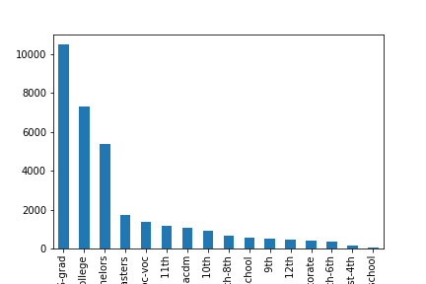
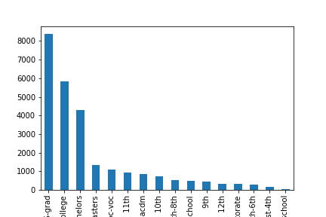
Sampling
Original Data
Training Data

Slide 5
Sampling
Sometime the data comes not in finite data sets, but in datastreams, or are so large we cannot handle them all at once. Either way the size our data set is unknown.
For these cases we may use Reservoir Sampling.
We set our sample size, or reservoir size, ( r ).
We take the first r instances that come into initialize out reservoir, then
each instance that comes would have a r/(r+1) probability replace a random instance in our reservoir. We can stop at any time and use our reservoir.

Slide 6
Sampling
Example:
3 1 2 6 2 7 9 4 4 1 7 2 8 5 3 7 5 5 0 0 8 5 7 1 2 3 4 1 3 2 4 2 8 6 1 1 1 4 9 2 9 0 6 5
Reservoir = {}
r= 10 with sampling probability = 0.91

Slide 7
Sampling
Example:
7 2 8 5 3 7 5 5 0 0 8 5 7 1 2 3 4 1 3 2 4 2 8 6 1 1 1 4 9 2 9 0 6 5 8 9 9 3 4 6 1 9 7 8
Reservoir = { 3 1 2 6 2 7 9 4 4 1 }
r= 10 with sampling probability = 0.91
We generate p = 99, so we are not adding 7 to our reservoir.

Slide 8
Sampling
Example:
2 8 5 3 7 5 5 0 0 8 5 7 1 2 3 4 1 3 2 4 2 8 6 1 1 1 4 9 2 9 0 6 5 8 9 9 3 4 6 1 9 7 8 6
Reservoir = { 3 1 2 6 2 7 9 4 4 1 }
r= 10 with sampling probability = 0.91
We generate p = .91, so we will add 2 to our reservoir in the randomly selected 8th place.
Reservoir = { 3 1 2 6 2 7 9 2 4 1 }

Slide 9
One-Class Learning
Many of our classification techniques are binary, meaning the classify examples into one of two classes.
One-Class Learning classifies examples as member of a known class and unknown. They key difference is that we only have examples for one class, and we don’t know any other labels.
This type of problem is called an Outlier Detection problem or a Novelty Detection problem.

Slide 10
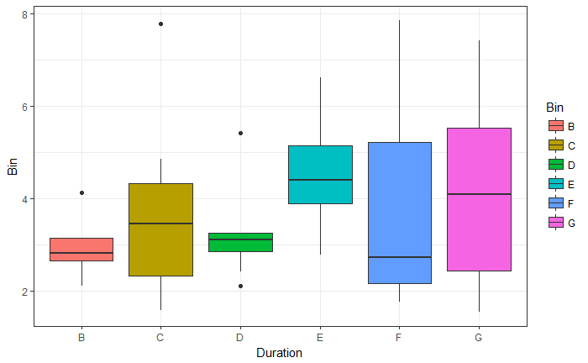
One-Class Learning
One the method is to identify instances beyond a distance d from a specified percentage p of the data.
Z-scores can be used of the data
Follows a normal distribution.

Slide 11
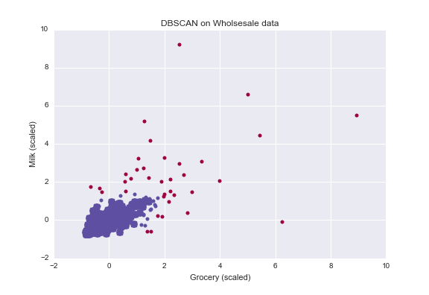
One-Class Learning
One the method is to identify instances beyond a distance d from a specified percentage p of the data.
Remember the DBSCAN clustering algorithm?
It can detect outliers based on density of data
points.
https://datascience-enthusiast.com/Python/DBSCAN_Kmeans.html

Slide 12
Multiple Classes into Binary
One-vs-rest
Pairwise Classification
Error-Correction Output Codes

Slide 13
Multiple Classes into Binary
One-vs-rest is a technique in which you run N, two class classification, 1 for each class.
N datasets are customized for each run. Classifying one class versus the other classes.
Original Data |  | Data Set 1 | Data Set 2 | Data Set 3
example 0 | class 1 | e0, class 1 | e0, not class 2 | e0, not class 3
example 1 | class 2 | e1, not class 1 | e1, class 2 | e1, not class 3
example 2 | class 2 | e2, not class 1 | e2, class 2 | e2, not class 3
example 3 | class 2 | e3, not class 1 | e3, class 2 | e3, not class 3
example 4 | class 3 | e4, not class 1 | e4, not class 2 | e4, class 3
example 5 | class 1 | e5, class 1 | e5, not class 2 | e5, not class 3
example 6 | class 3 | e6, not class 1 | e6, not class 2 | e6, class 3
example 7 | class 1 | e7, class 1 | e7, not class 2 | e7, no class 3
example 8 | class 3 | e8, not class 1 | e8, not class 2 | e8, class 3

Slide 14
Multiple Classes into Binary
Pairwise Classification is a technique in which you build a classifier for every pair of classes and set up the data to only have examples that pertain to those classes.
Then you use a voting like system to determine class of new examples.
Original Data |  | Data Set 1 | Data Set 2 | Data Set 3
example 0 | class 1 | class 1 | class 1
example 1 | class 2 | class 2 |  | class 2
example 2 | class 2 | class 2 |  | class 2
example 3 | class 2 | class 2 |  | class 2
example 4 | class 3 |  | class 3 | class 3
example 5 | class 1 | class 1 | class 1
example 6 | class 3 |  | class 3 | class 3
example 7 | class 1 | class 1
example 8 | class 3 |  | class 3 | class 3
 | classifier 1 | classifier 2 | classifier 3
New 1 | 1 | 1 | 2
New 2 | 1 | 2 | 3

Slide 15
Multiple Classes into Binary
Error-Correction Output Codes is a technique where a ensemble of classifier are used to classify a new example.
The outputs of the classifiers are encoded into a binary Class Vector. The vector is then compared, using hamming distance, to the expected class vector for each class.
The new example will get classified base on the closest expected class vector.

Slide 16
Multiple Classes into Binary
Class | cl1 | cl2 | cl3 | cl4 | cl5
 | Class Vector
1 | 1 | 0 | 1 | 1 | 0
2 | 0 | 1 | 1 | 0 | 0
3 | 1 | 1 | 0 | 0 | 1
4 | 0 | 0 | 1 | 1 | 1

Slide 17
Multiple Classes into Binary
Class | cl1 | cl2 | cl3 | cl4 | cl5
 | Class Vector
1 | 1 | 0 | 1 | 1 | 0
2 | 0 | 1 | 1 | 0 | 0
3 | 1 | 1 | 0 | 0 | 1
4 | 0 | 0 | 1 | 1 | 1
 | Class Vector
? | 0 | 0 | 1 | 0 | 1

Slide 18
Multiple Classes into Binary
Class | cl1 | cl2 | cl3 | cl4 | cl5
 | Class Vector
1 | 1 | 0 | 1 | 1 | 0
2 | 0 | 1 | 1 | 0 | 0
3 | 1 | 1 | 0 | 0 | 1
4 | 0 | 0 | 1 | 1 | 1
Class | Distance
1 | 3
2 | 2
3 | 3
4 | 1
 | Class Vector
? | 0 | 0 | 1 | 0 | 1

Slide 19
Multiple Classes into Binary
Class | cl1 | cl2 | cl3 | cl4 | cl5
 | Class Vector
1 | 1 | 0 | 1 | 1 | 0
2 | 0 | 1 | 1 | 0 | 0
3 | 1 | 1 | 0 | 0 | 1
4 | 0 | 0 | 1 | 1 | 1
So we classify the new instance as Class 4
Class | Distance
1 | 3
2 | 2
3 | 3
4 | 1
 | Class Vector
? | 0 | 0 | 1 | 0 | 1

Slide 20
Multiple Classes into Binary
Ensemble Nested Dichotomies
{a,b,c,d}
{a,b} {c,d}
{a} {b} {c} {d}
Class | Class Vector
a | 0 0 X
b | 0 1 X
c | 1 X 1
d | 1 X 0

Slide 21
What we covered.
Sampling
One-Class
Multiple Classes to Binary

Slide 22
References
Shmueli, G., Bruce, P. C., Yahav, I., Patel, N. R., & Lichtendahl Jr, K. C. (2017). Data mining for business analytics: concepts, techniques, and applications in R. John Wiley & Sons.
Witten, I. H., Frank, E., Hall, M. A., & Pal, C. J. (2016). Data Mining: Practical Machine Learning Tools and Techniques.

